Slide 1
The Economics of Cheon IL Guk
King Ho
Feb 2016

Slide 2
Table of Content
Introduction
The Happiness Portfolio
The Focus Questions regarding an ideal economic system
Good people vs good system
Socialism vs capitalism
Harmony vs competition
Common ownership vs private property
Centralized planning vs free enterprise
Big government vs limited/minimal government
Welfare vs work requirement
(D) The human body: model of an ideal economic system
(E) Conclusion
References
Appendix

Slide 3
(A) Introduction – happiness
Everyone is struggling to attain happiness and avoid misfortune…How, then, does happiness arise? People feel joy when their desires are fulfilled. (Divine Principle P.1)
To realize joy, God blessed three great blessings to the first human ancestor to be fruitful, multiply and have dominion over the creation. This implied that God wants human being to become owner and establish Heavenly Kingdom on earth. (Tang Kimsruy)
Cheon Il Guk means the Nation of Cosmic Peace and Unity. This nation is world where all humanity, both physical and spiritual live in attending God as their parents.

Slide 4
Cheon Il Guk
The translation is straightforward: Guk (nation) Cheonju (of cosmic) Pyeong Hwa (peace) Tongil (unity). The explanation was esoteric, but it encapsulates Rev Moon’s life-long philosophy of “two becoming one”. For him, this extends to the unity between mind and body in the individual; husband and wife, parents and children, elder and younger siblings in the family; leaders and followers, employers and employees, religious and secular realms in society; humankind and the natural environment in the world; heaven and earth, or what members referred to as spirit world and physical world, in the cosmos; and most importantly, the unity between God and humankind. (Mickler)
Yet, God’s original purpose to build CIG (Heavenly Kingdom on earth) was left unfulfilled due to the Fall of the first human ancestors

Slide 5
Economic and wealth
Standard dictionaries, such as Webster’s, define the following terms as follows:
Economic: of the production, distribution and consumption of wealth.
Wealth: large possessions of money, goods, or land; great abundance of worldly goods.

Slide 6
An ideal economic system
There can be no question that God, as the creator of human beings and the Father of humankind, wishes to provide for His children in every way. It must therefore be God’s Will that an economic system be established which offers each person the opportunity to be well-cared for and satisfied in an economic sense. (CAUSA)

Slide 7
An ideal economic system
An ideal economic system is Principled/Unification Economics based on Applied Divine Principle/Original Divine Principle/Unification Thought/Godism/Headwing Ideology
It should be built on the basic of a new ideology and practice that can solve the structural problem of existing economic systems (Teshigawara)
It should be an integral system that also consists of political, cultural and moral aspects

Slide 8
Failures of the unprincipled economic activities
The unfortunate consequences of such un-principled economic activity, though often unintentional, are: the exploitation of individuals, the breakdown of families, the disintegration of community, and the violation of the environment. When the un-principled actions are intentional, the consequences are even greater. Self-interest, narrowly understood, becomes the guide for behaviour, and one seeks to get away with whatever is possible. (Durst)

Slide 9
Objectives of the Principled Economics
To realize the full possibilities of material wealth creation for the greatest number of people
To contribute spiritual well-being for the individual, family and society during the process of wealth creation
To realize the Three Great Blessing

Slide 10
(B) The Happiness Portfolio
First, genetic 48%
Second, current events 40%
Third, 12% is under our control
To maximize the 4 values: faith, family, community and meaningful work (Brooks)
To maximize the Three Great Blessing

Slide 11
The Three Great Blessing
The Three Blessing correspond to three important aspects of human life. The call to be fruitful, implies that the spiritual mind must come to dominate the physical mind. The fulfillment of this, Rev. Moon has clarified, relates to religion (faith). The second blessing relates to family and the family provides a framework for the community… it also should thus serve as the basis for proper ethical and political relations. The third blessing clearly relates to economy and the proper relationship with nature and things. (Ward)

Slide 12
(C) The Focus Questions regarding an ideal economic system:
1) Good people vs good system
2) Socialism vs capitalism
3) Harmony vs competition
4) Common ownership vs private property
5) Centralized planning vs free enterprise
6) Big government vs limited/minimal government
7) Welfare vs work requirements

Slide 13
1) Good people vs good system
There is no one who can explain the concrete system of Cheon Il Guk. But then is it possible to realize something without any clear vision and goal?....Cheon Il Guk is not the nation that can automatically be built by God’s miraculous power. The ideal of interdependence, mutual prosperity and universally shared values should be established through cooperation between God and human beings. (Teshigawara)

Slide 14
Good System is important
Regrettably, even inside the Unification Movement, a large number of people are reluctant to establish a concrete system for Cheon Il Guk. Their main insistence is that if the ideal world consists of “original” people (persons without fallen nature) and ideal families, the external structure will not be so important. However, it is a naive way of thinking that “original” people will do well whatever the system. (Teshigawara)

Slide 15
Question 1) Conclusion
The ideal economic situation requires the existence of both an ideal economic system and the original people

Slide 16
2) Socialism vs capitalism
Because human beings are created to live in an ideal society, they will inevitably pursue a socialistic ideal as they strive for freedom and democracy and further search into their original nature. (Exposition of the Divine Principle, p342)
God’s plan is to develop a socialistic economy, although with a form and content utterly different from the state socialism that communism actually established. (P.341)

Slide 17
equal living conditions
This is because the term socialistic has a broad meaning: for example, we can regard the European welfare state as a socialistic ideal in a broad sense. What Divine Principle wants to say regarding the “socialistic ideal” is not that the ideal world should be planned and controlled from government, but that the ideal world should provide equal living conditions to all people. i.e. “Just as parents love all their children equally, God desires to provide pleasant environments and living conditions equally to all His children”(P.341) This is utterly different from the state socialism that communism actually established. (Teshigawara)

Slide 18
democratic economic system
The ideal society is further described as “a truly democratic economic system” (Divine Principle, p.343)
… where the consumer “votes” in a “democratic economic system”. Obviously the consumer votes at the marketplace, whenever he or she shops. (Hendricks, 2006)
Unification Thought recognizes the value of the market economy, especially if it is balanced between self interest (purpose of the individual) and sympathy (purpose of the whole, especially if sympathy is understood as “object consciousness” as explained in the Unification Thought) as espoused by Adam Smith in his original explanation of it. (Ward)

Slide 19
freedom and responsibility to foster economic prosperity
According to Divine Principle, man has freedom and responsibility and is the temple of God. Capitalism more than any other economic system allows people to use their freedom and responsibility to foster economic prosperity. If God dwells within each individual, then certainly that person should have the right and authority to have his own business. Divine Principle does not say only central planners of the government are the temple of God, but that all people are to be temple of God. (Hewes)

Slide 20
individual and whole purposes
Capitalism does an excellent job of harmonizing the individual and whole purposes. If a business is successful, then it is serving the whole purpose because of its many customers. If a company fails to serve the society, it will go out of business. Even if a businessman’s motivation is totally selfish, he or she must still serve customers with a decent product or risk failure.
In line with this is the biblical maxim, ”What a man sows, so shall he reap.” if a person does work hard providing a quality product or service for consumers, shouldn’t that person also benefit? (Hewes)

Slide 21
how much a person should receive
The market is the best determiner of how much a person should receive. The amount of wages or profits a person or company makes is a function of how much they contribute to society. Dr. Lee, author of Unification Thought, says : The capitalist is naturally entitled to receive a part of the earnings of the enterprise because he has exerted creative power either engaging in business activity or by providing capital for it….[T]he exploitation of laborers by capitalists is not that capitalists seize the surplus value (profit) produced by the laborers, but rather that capitalists take an undue portion of the profit produced jointly by capitalists and laborers. (Unification Thought, p.284)

Slide 22
workers as owners
The ideal corporate form will have all the workers as owners. Each worker thus has a stake in the company, providing incentive for quality work. (Hewes)

Slide 23
family businesses
Unificationism affirms the family, not the government, as the cornerstone of the Kingdom of God. Thousands of family businesses have sprung up under capitalism. In a family business, children can learn how to work and even earn money to go to college. Give and take action is an essential component of capitalism yet is virtually nonexistent in socialist economies. Under capitalism the exchange of goods and services is voluntary and thus there is true give and take action that benefits all parties. (Hewes)

Slide 24
true give and take
The key insight of Adam Smith’s Wealth of Nations is misleadingly simple : if an exchange between two parties is voluntary, it will not take place unless both believe they will benefit from it. Most economic fallacies derive from the neglect of this simple insight, from the tendency to assume that there is a fixed pie, that one party must gain at the expense of the another. (Friedman)

Slide 25
true give and take
Thus in a voluntary transaction both parties gain benefit. This is the essence of true give and take action. There is no zero sum gain – the pie gets bigger.
Price regulates supply and demand and fosters the give and take action. In a socialist command economy rather than both parties benefiting both parties lose or only one party gains. In capitalism, if both parties do not gain, there is no transaction. (Hewes)

Slide 26
More effort to get more reward
Capitalism more than any other economic system gives people incentive to work and produce goods and services. Rev. Moon in an interview with a Soviet journalist indicated that incentives must be an essential component of an economic system. (Hewes)

Slide 27
creativity
Divine Principle affirms creativity as an attribute of human nature. Only in capitalism is creativity fostered to its utmost. Capitalism thrives on creativity, innovation and inventions. Through our patent and copyright laws one is rewarded for their creativity while simultaneously allowing society to benefit by the invention. (Hewes)

Slide 28
man as lord of creation
Divine Principle affirms man as lord of creation. Man was not created to merely obey orders from a “central planner”, like angels do. But man is to explore, initiate and create to better serve humanity. Capitalism is the economic system best suited to do this. (Hewes)
Giving each person control and ownership sounds as if we have private property, a free market (the ability to buy and sell your property) and free labour (ownership of one’s mind and body, energy and time). This is capitalism. (Hendricks)

Slide 29
human nature
Socialist systems abrogate the rights of private property, exert state controls and deny individual free choice. In doing so, they directly oppose three basic aspects of human nature :(1) the desire to better oneself, (2) creativity, and (3) the drive to achieve. Because they oppose these basic human traits, they are sure to fail. (Hendricks)

Slide 30
Question 2) Conclusion
The capitalist system could be cruel and inhuman, if the people in charge of the economic system only think in their personal interest, and could be less cruel and inhumane, if the people in charge of the economy behave as a human. (Pedraza)
One key element to making free markets work well is "the level playing field". This means things such as fair laws and lots of transparency.
However, the capitalism is better than the socialism because it is more ethical and leads to better performance
Unfortunately, socialism is like a cart that has to be drawn by ten people, and they're equally responsible for the progress they make, but it doesn't much matter whether they do any pulling. Many of those able and inclined to pull will finally get the picture and just stop pulling. Invariably, to get the cart going again, someone has to be empowered to make everyone work harder. Those who don't want to pull or cannot pull because of any infirmity know that they are living in a just society, and they expect to live a comfortable life. They get it. (Teal)

Slide 31
3) Harmony vs competition
In Christian history most prophetic figures poured forth visions of a perfect world that somehow came to be expressed in socialistic terms. Generosity and sharing take the form of “no ownership”. Internal peace takes the form of “no work”. Harmony among all takes the form of “no competition”. Visions of a world of love fuzz out into “social welfare”. Visions of True Parents caring for all their children fuzz out into “communal child care”. I appeal to those Unificationists who applaud careful thinking and respect for historical experience over against ideology-based perfectionism to challenge this type of thinking. (Hendricks)

Slide 32
Competition of service
Father constantly tells us to be superior to the outside world. I interpret this to mean that we do better financially than the national average. And we should do it in less hours so we can devote some time to witnessing and Father’s campaigns… in 1994 Father gave an example of how to do good business: “One reason our fish distribution centre has been so successful is that it stays open until midnight to obtain what the customer wants… The only way to secure markets is through service.” (John Godwin)

Slide 33
Competition of service
It is a competition of service that wins customers. Father said, “Do we want to be out-done by others or win the competition? Of course, we want to win. To do so, we have to work harder and with greater concentration and confidence. If outside people work eight hours, we have to work nine or ten hours.” (John Godwin)

Slide 34
Competition requires market
“Free access to markets” means workers may choose where to work, employers may choose where to hire, consumers may choose what to buy, companies may choose what to sell, and stockholders may choose what venture to invest in… This should result in healthy competition from market participants. If competition becomes unhealthy and destructive, then the law steps in with various anti-trust laws and regulations about unfair business practices, to promote a healthy competition that is beneficial for society…. (Hewes)

Slide 35
Price is an indictor of your service
The market is the best and most efficient way to allocate the production, distribution and consumption of goods and services, and the best determiner of prices, profits, wages and interest rates. Why? Because the market price is the value society places upon your goods or services. Therefore the market price is a function of your contribution to the whole purpose – that is society. If consumers do not buy your goods or services, it is because society does not value it and you will soon be out of business because you are not contributing to society. (Hewes)

Slide 36
Question 3) Conclusion
Competition is prerequisite for all kinds of improvement. It keeps prices down and quality high

Slide 37
4) Common ownership vs private property
Is it evil or selfish to advocate private property? The debate over private property has been going on at least since Aristotle condemned Plato for advocating the abolition of private property: Such legislation may have a specious appearance of benevolence. Men readily listen to it and are easily induced to believe that in some wonderful manner everybody will become everybody’s friend, especially when someone is heard denouncing the evils now existing in states, suits about contracts, convictions for perjury, flatters of rich men and the like, which are said to rise out of the possession of private property. These evils, however, are due to a very different cause – the wickedness of human nature. (Aristole, Politics, Book II pp. 44-45)

Slide 38
Private property is the third blessing
Plato , like the socialists and Marxists of today advocated the abolition of private property. But it is not private property that makes men selfish or wicked. Rather, that is a problem of the spirit. Furthermore, how can we be generous and giving if we have nothing to give? Certainly a prerequisite to sharing is having something to share.
The third blessing of Divine Principle gives us dominion over creation. Private property is necessary to fulfill this third blessing. Each person must learn how to care for his or her house, garden or consumer goods. Each person must be given the opportunity to grow spiritually by sharing his property with others.
The American idea of having a blend of private and public lands seems to work quite well. We have public property for schools, government facilities, highways and parks. But we also have private property for business, religion, recreation, sports and housing. (Hewes)

Slide 39
Private property for the good of others
Concerning ownership, in Divine Principle, God is the owner and controller, and God distributes ownership and control to individuals, not to families, communities, nations or the world. This is part of the Third Blessing, of dominion over creation. Each individual, as part of a blessed central family, is an owner (or king), parent and teacher. Human beings have responsibility of dominion as individuals, beginning with their own physical body, their labour, their time and mental and spiritual capacities and talents. Our conscience tells us to develop these and invest them for the good of others. (CAUSA)

Slide 40
Private property for the good of others
The right of private property is not absolute, however, those who own property have responsibilities to God, to their communities, and to all their fellow human beings. Thomas Aquinas once wrote that a human being “ought to possess external things not as his own but…..so that….he is ready to communicate them to others in their need. Hence, the Apostle says (1 Tim 6:17-18): ‘Charge the rich of this world… to give easily, to communicate to others.’” Owners are temporary stewards of a portion of the earth, and each one of us will one day give to the Creator an account of our stewardship. (CAUSA)

Slide 41
Question 4) Conclusion
Private ownership of property is the normative means by which the principle of common use is realized. For one thing, private property is essential for the development of self-reliance. Secondly, private property helps us express and develop our personalities. When we own things, we can choose to use them to express our concern for others, be it by giving people gifts or by investing in productive, job-creating industries. Thirdly, private ownership or the prospect of private ownership creates incentives for people to contribute in a wider way to the society around them. It encourages people to work, to be entrepreneurial, and to create wealth for themselves and others. Lastly, private property allows people to give direct expression of their genuine responsibility for themselves and for others.

Slide 42
To these moral justifications for private property, we may add the three reasons given by Aquinas to explain why appropriation of property to particular owners is morally licit and even necessary. First, individuals tend to shirk responsibilities that are nobody's in particular, and people tend to take better care of what is theirs than of what is common to everyone. Second, if everyone were responsible for everything, the result would be confusion. Third, dividing things up generally produces a more peaceful state of affairs, whilst sharing common things often results in tension. Individual ownership—understood as the power to manage and dispose of things—is then justified. (Gregg)

Slide 43
5) Centralized planning vs free enterprise
Definition: Centralized planning means that a few people in the government make the major business decisions, such as what sector to invest money in, what price a product should sell for, what wages to pay, where to obtain the financing, what interest rates should be, and where to obtain raw materials. An obvious drawback of centralized planning is that it is impractical in a society of hundreds of millions of people. It simply doesn’t work; and the economies of eastern Europe, the soviet Union, and North Korea show how inefficient and unproductive socialism is. Also, if central planner makes a bad decision, the whole economy may be affected. (CAUSA)

Slide 44
Free enterprise
In the decentralized economy of free enterprise, the major decisions are made by the tens of thousands of corporations, partnerships and sole proprietorships. The decisions are made by those people most affected by their consequences. These people know best their company’s situation as well as how workers, investors, lenders, and consumers will respond to their decisions. (Hewes)

Slide 45
Question 5) Conclusion
Central planning shines when a project is big, well understood, and doesn't change much with time.
The free market system is at its strongest when there is a lot of uncertainty, complexity and change involved in the project….. The virtue of the free market in these circumstances is fast adaptability (Bourke)

Slide 46
6) Big government vs limited/minimal government
To what extent should government control the economy? It is desirable that production and distribution be undertaken at places nearest to people’s lives. As such, the control of the central government must be minimized. Individuals and companies nearest to consumers are best suited to make production and distribution plans by analyzing consumption trends themselves. Cheon Il Guk affirms “consumer sovereignty” (Teshigawara)

Slide 47
Function of Government
Government control should be limited to 1) the administration of natural resources which have a direct influence on the earth’s ecosystem; and 2) businesses with highly public needs. i.e., city planning, public transportation, education, postal service and medical services. Production of consumer goods as well as service industries required to meet the diverse tastes and preferences of consumers should be left to the private sector. (Teshigawara)

Slide 48
government redistribution is ineffective
The scientific study of government reveals that governments have the power to redistribute wealth by force, and can modify inequity to some degree. However, governments not only need producers to create the wealth that they will divide, but they also cost money to operate and take a chunk out of the pie that would otherwise be divided between producers and dependents. Thus government redistribution is not only a win-lose situation, unlike the win-win of the competitive market, but the expense of government comes at the cost of reduced overall economic growth. (Anderson)

Slide 49
Ideal conditions for a government
Government work should be voluntary service, and workers produce their personal economic support outside the government job. Social services of churches tend to function along these lines.
Government decisions would need to be free of conflicts of interest, and reflect the will of a large majority of people.
Government agencies would need to be structured to reduce the number of beneficiaries of welfare by successfully enabling them to become capable producers in a competitive marketplace. But today agencies are paid based upon the number of people they serve, so it is in their interest to keep people dependent and increase the number of people in their care. (Anderson, 2015)

Slide 50
Question 6) Conclusion
Small government was best summarized by the principal author of the Declaration of Independence and third President of the United States Thomas Jefferson when he claimed, “That government is best which governs least, because its people discipline themselves.” (Lewis)

Slide 51
7) Welfare vs work requirements
Problem of the current safety net: it does not equip citizens to build meaningful dignified lives of their own making
Conservatives define success by how few people need help from government programs, not how many we can enroll for government help
True compassion means telling a friend. “I can’t help you if you don’t stop using drug.” It means only helping people who are ready to help themselves. It means providing genuine support that effectively addresses the whole person (Brooks)

Slide 52
Poverty as moral issue
Poor people really need is opportunity (vs charity). That is why conservatives insist on work as the central solution to poverty.
Poverty in America is often intertwined with social pathologies, such as substance abuse, criminality, domestic violence, and other problems. Values thus play a pivotal role in determining whether people live in prosperity or poverty.
Brooking Institute survey results (Brooks)

Slide 53
Prerequisite of an opportunity society
An opportunity society has two basic building blocks. First is an education system that creates a base of human capital. Second comes an economic system that rewards hard work, merit, innovation, and personal responsibility. (Brooks)

Slide 54
Question 7) Conclusion
There should clearly be a public policy preference for work over welfare. The current welfare system provides such a high level of benefits that it acts as a disincentive for work. (Tanner)

Slide 55
(D) The human body: model of an ideal economic system
God has given us a model illustrating the proper balance between central coordination and individual freedom in the form of the human body itself. We interpret the functioning of the body in human, social and economic terms, holding fast to three basic principles: the sacred dignity of the person, the social nature of human life, and the obligation to assign social decisions to the level of authority best suited to take them. (CAUSA)

Slide 56
individual freedom and central coordination
The human body exhibits a beautiful and harmonious balance between individual freedom and central coordination. Within the body, each cell, although it forms part of some body organ or tissue, is required to maintain itself autonomously. That is, the cell is responsible for its own metabolism, and determines how much nutrients and oxygen it will draw from the bloodstream. The body, then, operates in accord with principles like those found in a free market system. (CAUSA)

Slide 57
the body are largely self-regulating
Although centrally coordinated, the organic functions of the body are largely self-regulating. The stomach resists attempts to over-stuff it. The liver responds to shortages in the blood, by releasing stored-up nutrients. The heart and lungs adjust their rates according to the body demands. The more we examine in detail the functioning of the body, the more we see a remarkable balance between central coordination and individual autonomy and decision-making. It is the position of CAUSA that the body is a God-given model of a proper economic system. (CAUSA)

Slide 58
The Principled Economic System is a free market system with conscience
Rev. moon has strongly emphasized the need for strengthened the conscience. As the conscience is strengthened, the desire to do what is right is also strengthened. This will have an impact on everything, including the motivation and heart with which one deals with economic and socioeconomic affairs. (Ward)
Free market system would be the best system to accommodate the basic human desires. The desire to better oneself is served by the opportunity which free markets give to material incentives. The desire to be creative is served by the freedom of the market. And the desire to achieve is served by the opportunities created for fair competition. (CAUSA)

Slide 59
intervention if there is a serious disorder
The Principled Economic System is the system which most closely resembles the functioning of the human body. It allows individuals to draw from the market as they see fit, but allows for intervention if there is a serious disorder. The system maintains medical forces to come to the aid of stricken individuals, and security forces to enforce laws made for the good of the whole. These forces are only called into action as needed, however, and the system generally functions without them. (CAUSA)

Slide 60
Market observe the needs of others
The Principled Economic System which allows economic agents regular, reliable, ordinary liberties. This market system respects the free creativity of every human person, and for this reason respects private property, incentives (rather than coercion), freedom of choice, and the other institutions of a free economy. A market system obliges its participants to be “other-regarding,” that is, to observe the freely expressed needs and desires of others, in order to serve them. A market system is not morally validated because it is productive, for any economy can achieve a certain productivity through coercion. A market system is moral because it is the only system built upon the liberty of its participants. (CAUSA)

Slide 61
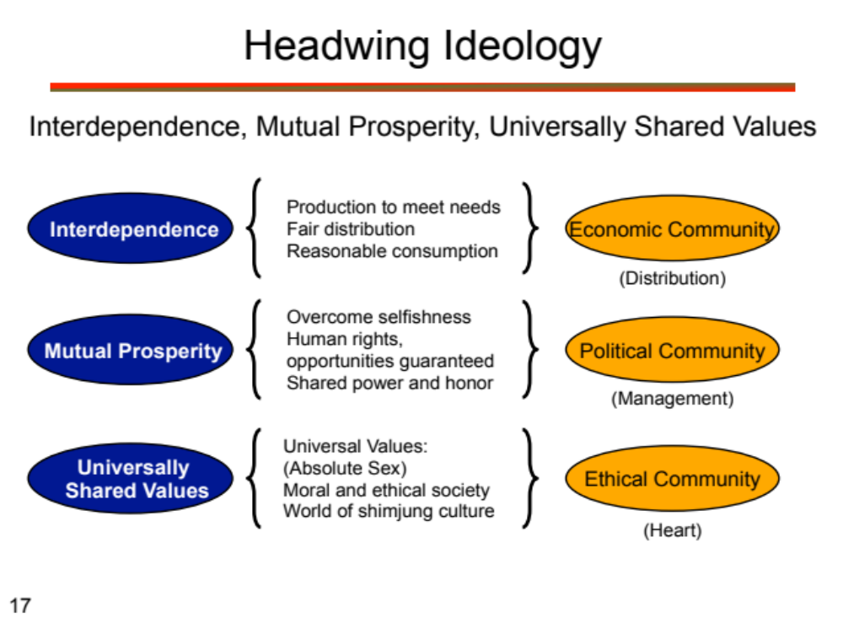

Slide 62
Interdependence
“Ownership” in both capitalist and socialist economies are simply material possession. They lack the dimension of love. Human beings were to exercise joint ownership (stewardship) over all things–with a heart of gratitude to God. In Creation for example all birds “own” the sky; all fish “own” the ocean, all animals “own” the land. No single bird, fish or animal monopolizes everything.
In a family, the property is legally owned by the parents. But more important than a legal document, children always have a heart of gratitude and love towards their parents and take good care of the family property as if it were their own.

Slide 63
Mutual Prosperity
This is “ownership of government” and requires a public-minded attitude; it is spiritual in nature. In Western societies the policy of separating church and state has, in effect, removed ethical and moral principles from governing. Communists call themselves a “people’s democracy,” but outlaw religion altogether. Both systems of government have become self-serving: “governments of their party, by their party, for their party.” If the spiritual and moral dimensions of social order are not addressed, then these economic developments will be undermined, as we are seeing today in both democratic and communist societies

Slide 64
Universally Shared Values
The concept of universal values is the very core of an ideal society. If we cannot find universal ethics and morals that resonate with all cultures and religions, we will never be able to create a world that is peaceful, interdependent and co-prosperous

Slide 65
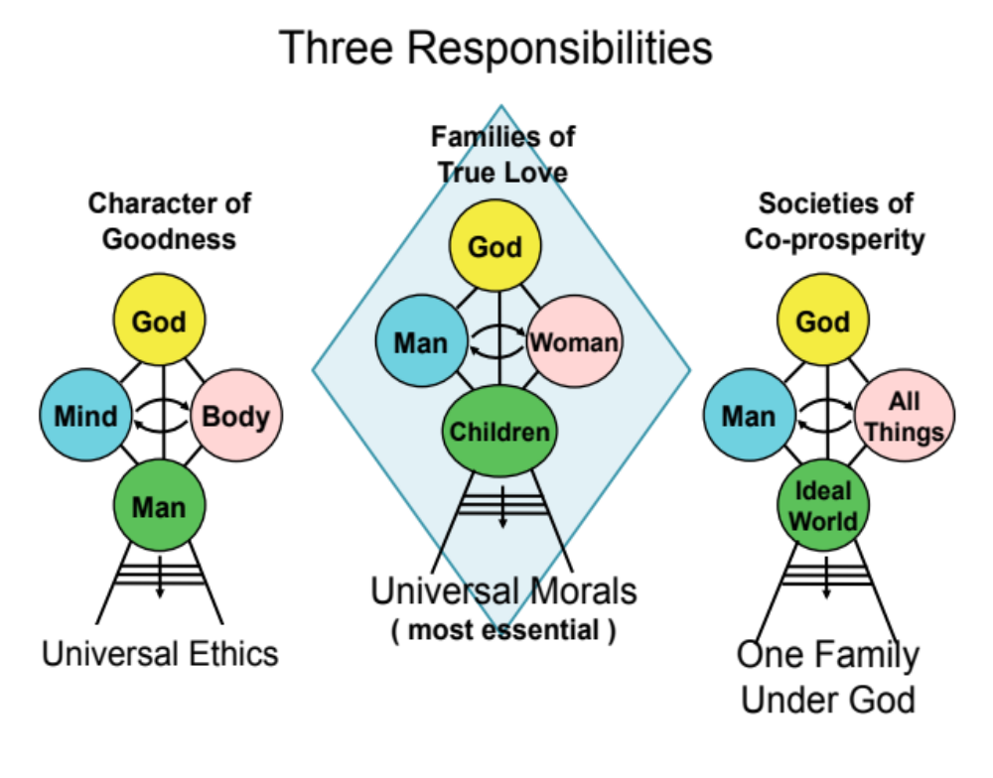

Slide 66
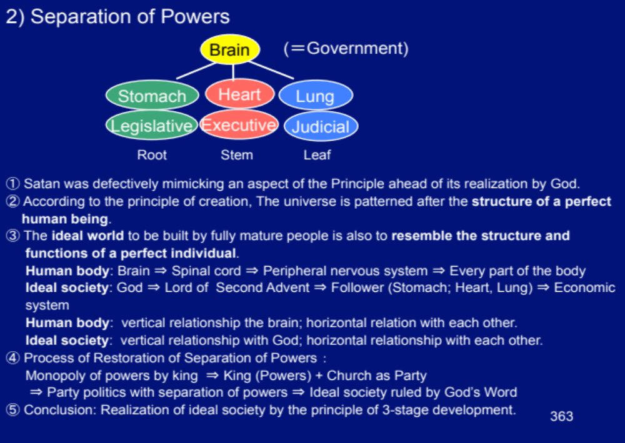

Slide 67
separation of powers
The concept of the separation of powers into three branches of government was advocated by the Montesquieu (1689 – 1755), a leading thinker of the Enlightenment. It sought to prevent the concentration of political power in the hands of a single individual or institution, as was the case with political absolutism. The idea was proclaimed in the Declaration of the Right of Man during the French Revolution.

Slide 68
the three branches of government
In the human body, the lungs, heart and stomach maintain harmonious interaction in accord with the directions of the brain, transmitted through the spinal cord and the peripheral nervous system. By analogy, the three branches of government in the real world – the legislative, judicial and executive branches – will interact in harmonious and principles relationships when they follow God’s guidance as conveyed through Christ and people of God. Just as the four limbs of the body move according to the commands of the brain for the welfare of the individual as a whole, the economic institutions of the ideal world, corresponding to the limbs, will uphold the desire of God and promote the welfare of the entire world. Just as the liver stores nourishment for the entire body, in the ideal world there will always be a certain reserve to be tapped as needed for the public good. (CAUSA)

Slide 69
Today’s democracies
Today’s democracies, characterized by the three separate branches of government and a proliferation of political parities, resemble the structure of a healthy human body to some extent. Nevertheless, because of the fall, today’s democracies in fact bear more of a likeness to the body of a sick or injured person. They cannot fully display their original qualities and functions in their full potential. Since the political parties are ignorant of the Will of God, they may be compared to a nervous system which is unable to transmit directions from the brain. (Divine Principle pp361 -363)

Slide 70
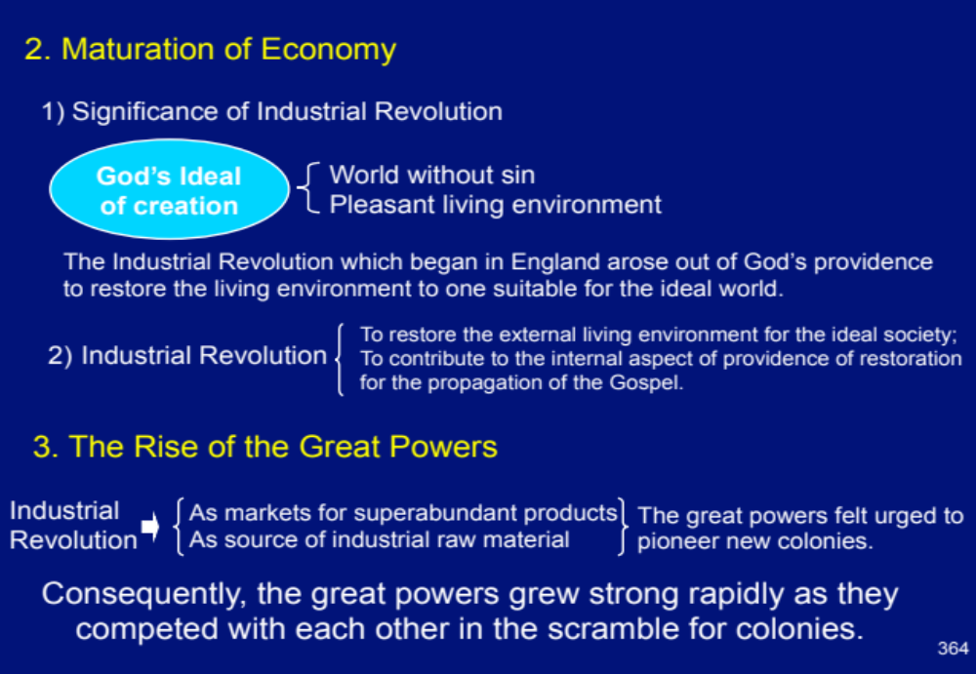

Slide 71
Significance of Industrial Revolution
God’s ideal of creation cannot be fulfilled merely by forming a world without sin. God blessed human beings to have dominion over the universe. We are to seek for the hidden laws of nature and advance science and technology to create a pleasant living environment.
Thus, we can understand that the Industrial revolution which began in England arouse out of God’s providence to restore the living environment to one suitable for the ideal world. (Divine Principle, P363)

Slide 72
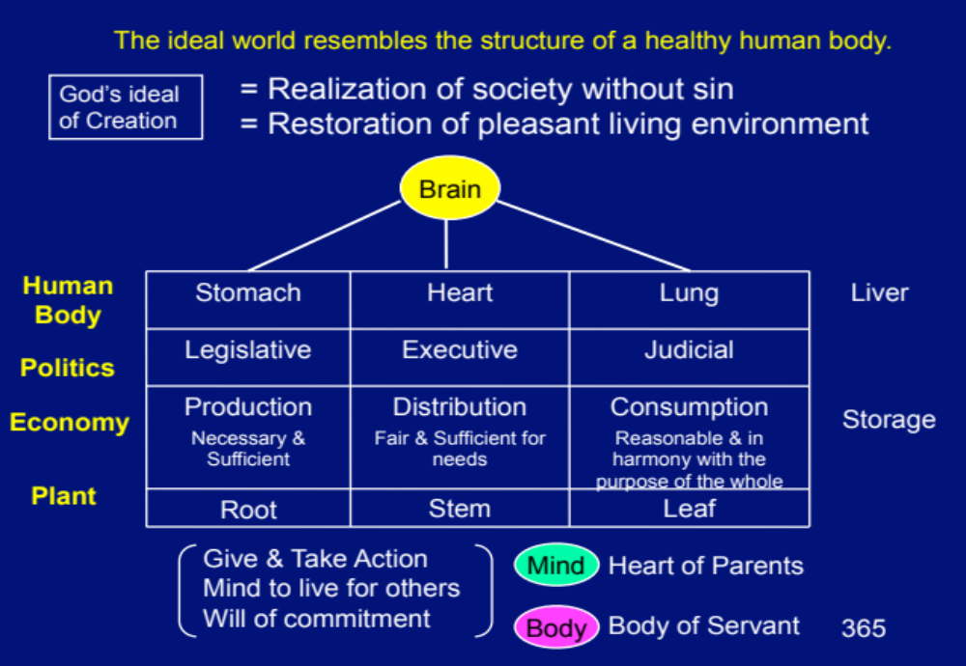

Slide 73
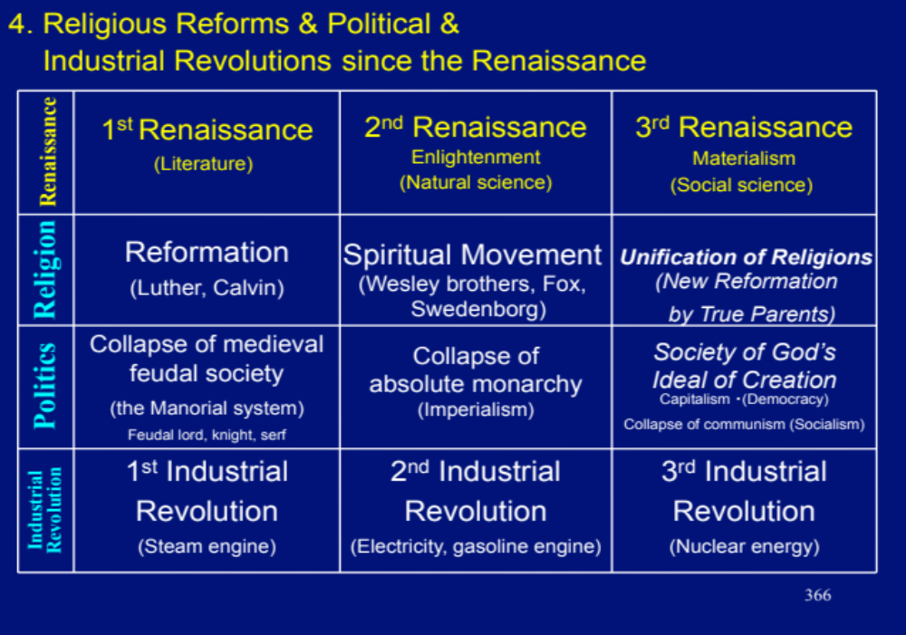

Slide 74
production, distribution and consumption
Moreover, in an ideal society, production, distribution and consumption should have the same organic relationship as exists between the functions of digestion, circulation and metabolism in the human body. Thus, there should not be destructive competition due to over-production, nor unfair distribution leading to excessive accumulation and consumption, which are contrary to the purpose of the public good. There should be sufficient production of necessary and useful goods, fair and efficient distribution of these goods, and reasonable consumption which is in harmony with the purpose of the whole. Just as the liver provides a reserve of nutrients for the human body, adequate reserves of capital should be maintained to ensure smooth operation of the entire economy. (DP P342)

Slide 75
Principled economy is based upon individual decision-making
The behavior of whole cell populations may be predictable, but not that of the individual cell. Similarly, the behavior of human populations is predictable, but not that of individual person. A tomato sauce manufacturer can say with certainty that Dutchess County will consume a half-ton of tomato sauce this month, but will fail entirely to predict when during this month my family will hit the sauce. That is my decision; it is not decided by centralized planning, just as the cell’s behavior is decided by the cell in relationship to the options presented in its environment. Thus, the Unification economy, using the body analogy, is based upon individual decision-making. This we call, shopping. (Hendricks)

Slide 76
Body has an invisible hand
Not only do I not consciously decide what my cells are doing, neither do I control what my liver is deciding, or my heart, lungs, stomach and lymphatic system. These organs are at the service of my cells. They run according to the autonomous nervous system. They run by what Adam Smith called, in the economic sphere, the invisible hand. My body has an invisible hand controlling its basic organic functioning. The organs serve the needs of the cells, in the context of what I consciously decide to eat, how much I decide to exercise, and the amount of stress I place on my system. If my cells need more oxygen, my lung breathe harder and faster. If my cells need to eliminate waste, my heart pumps more blood. If my cells need more fuel, my stomach starts growing. (Hendricks)

Slide 77
body analogy
Analogously, individual cope with the impact of major heteronymous economic decisions: the price of fuel and food, the tax rate, the regulations having to do with health care and inheritance, the availability of transportation and communications, the long-term impact of economy on the environment, and so forth. But all these coping decisions – as is the case with the body analogy – are made by individual actors and corporations. Thus, the Principle model is one of free market, free labour capitalism with governmental decision making over major fiduciary needs, but most of these decisions – those of the banks, major industries and regulatory agencies – are made in response to the needs of the individuals (the cells). (Hendricks)

Slide 78
Cells as life force
Lee, 1997 presents a detailed analysis of the human body analogy, and concludes that the creation of wealth comes not from any particular organ but from the body’s “life force” (cells) … in economy, creative power corresponds to the life force. Therefore, economy develops by enhancing the creative power of the people.

Slide 79
(E) Conclusion
Divine Principle recognizes that in order for the free market to emerge … it was first of all necessary for democracy to appear. For democracy to appear, it was first of all important that the Reformation occur. The Reformation caused the sovereign king to be viewed differently. Through a different understanding of the role of the king, it also became possible to recognize inequality in human beings and to appreciate the need for all people to have a political voice, which led to the emergence of democracy (Ward)
It is important to recognize that the heavenly kingdom on earth envisioned by Rev Moon is not a static monism. Its reality is more akin to Hegelian dialectics. The emphasis is less on being and more on becoming. (Mickler)

Slide 80
Money is spiritual: money can come and go. We should be more in tune with forces of wealth than anyone. Father says we “must become a professional in economic activities. If not, you can only become a beggar in the satanic world.” (John Godwin)

Slide 81
(F) References
Anderson, G. 6 July 2015, The Invisible Hand and the Reverse Invisible Hand
Bourke, R. Central Planning versus Free Markets
Brooks, A. 2015, The Conservative Heart: How to build a fairer, happier, and ,more prosperous America
CAUSA Institute, Jan. 1985, CAUSA Lecture Manual
Durst, M. Essays Toward a Principled Economics
The Family Federation for World Peace and Unification, 25 Oct 2011, The Original Substance of Divine Principle
Friedman, M. 1979, Free to Choose
Gregg, S. Private Property and Public Good
Godwin, J. Prosperity
Hendricks, T. 2006, Shopping in Cheon Il Guk: economics in the Unificationist Ideal World
Hewes, J., April 1991, In Defense of Capitalism
The Holy Spirit Association for the Unification of World Christianity, Exposition of the Divine Principle
Kimsruy, T. Good Citizens and Good Governance: Essences for Substantial Cheon Il Guk
LaValley, J. 20 April, 2015, Reconsidering Divine Principle’s Call to Create a Socialist Ideal

Slide 82
Lee, S.H., 1997, The Coming of Age of Head-Wing Thought: Beyond Communism
Lewis, M. Big government vs small government
Mickler, M. 2012, The beginnings of Cheon Il Guk, Journal of Unification Studies Vol. 13, PP139-174
Pedraza, J. M. Are good people who makes an economic system to be good, or are the systems good or bad intrinsically?
Redmond, J. 6 Jan. 2014, Movement, church or business?
Tanner, M. 2013, The work versus welfare tade-off:2013 An analysis of the total levels of welfare benefit by State
Teal, G. Why is socialism considered dangerous or bad for some people?
Teshigawara, H. 30 Dec. 2013, The Economic System in Cheon Il Guk.
Unification Thought Institute, 1992, Essentials of Unification Thought: The Head-wing Thought
Ward, T, 17 Feb. 2006, Addressing Poverty and Social Inequality – A Unification Thought Approach to Economic Development

Slide 83
(G) Appendix : Cows and Politics and Economics Explained (joke)
SOCIALISM: You have two cows. State takes one and give it to someone else.
COMMUNISM: You have two cows. State takes both of them and gives you milk.
FASCISM: You have two cows. State takes both of them and sell you milk.
NAZISM: You have two cows. State takes both of them and shoot you.
BUREAUCRACY: You have two cows. State takes both of them, kill one and spill the milk in system of sewage.
CAPITALISM: You have two cows. You sell one and buy a bull.
FEUDALISM: You have two cows. Your lord takes some of the milk. FEMINISM: You have two cows. They get married and adopt a veal calf.
TOTALITARIANISM: You have two cows. The government takes them and denies they ever existed. Milk is banned.
POLITICAL CORRECTNESS: You are associated with (the concept of "ownership“ is a symbol of the phallo-centric, war-mongering, intolerant past) two differently-aged (but no less valuable to society) bovines of non-specified gender.

Slide 84
AN AMERICAN REPUBLICAN: You have two cows. Your neighbor has none. So what?
AN AMERICAN DEMOCRAT: You have two cows. Your neighbor has none. You feel guilty for being successful. You vote people into office who tax your cows, forcing you to sell one to raise money to pay the tax. The people you voted for then take the tax money and buy a cow and give it to your neighbor. You feel righteous.
HONG KONG CAPITALISM: You have two cows. You sell three of them to your publicly listed company, using letters of credit opened by your brother-in-law at the bank, then execute a debt/equity swap with associated general offer so that you get all four cows back, with a tax deduction for keeping five cows. The milk rights of six cows are transferred via a Panamanian intermediary to a Cayman Islands company secretly owned by the majority shareholder, who sells the rights to all seven cows' milk back to the listed company. The annual report says that the company owns eight cows, with an option on one more. Meanwhile, you kill the two cows because the Feng Shui is bad.

Slide 85
AN AMERICAN CORPORATION: You have two cows. You sell one, and force the other to produce the milk of four cows. You are surprised when the cow drops dead.
A FRENCH CORPORATION: You have two cows. You go on strike because you want three cows.
A JAPANESE CORPORATION: You have two cows. You redesign them so they are one-tenth the size of an ordinary cow and produce twenty times the milk. You then create clever cow cartoon images called Cowkimon and market them World-Wide.
A GERMAN CORPORATION: You have two cows. You reengineer them so they live for 100 years, eat once a month, and milk themselves.
A BRITISH CORPORATION: You have two cows. They are mad. They die. Pass the shepherd's pie, please.
AN ITALIAN CORPORATION: You have two cows, but you don't know where they are. You break for lunch.
A RUSSIAN CORPORATION: You have two cows. You count them and learn you have five cows. You count them again and learn you have 42 cows. You count them again and learn you have 12 cows. You stop counting cows and open another bottle of vodka.
A SWISS CORPORATION: You have 5000 cows, none of which belong to you. You charge others for storing them.
A BRAZILIAN CORPORATION: You have two cows. You enter into a partnership with an American corporation. Soon you have 1000 cows and the American corporation declares bankruptcy.
AN INDIAN CORPORATION: You have two cows. You worship both of them.
A CHINESE CORPORATION: You have two cows. You have 300 people milking them. You claim full employment, high bovine productivity, and arrest the newsman who reported on them.

Slide 86
The end

